Slide 1
Using the method of joints, determine the forces in each member of the truss.
40 kN
50 kN
B
C
A
D
E
60 kN

Slide 2
V_{A} = 72.5 kN V_{D} = 77.5 kN
40 kN
50 kN
B
C
A
D
E
60 kN

Slide 3
JOINT A
F_{AB}
60°
A
F_{AE}
ΣFy = 0
V_{A} + F_{AB} sin60° = 0
F_{AB} = - 83.71 kN
V_{A} = 72.5 kN
Change the direction of arrow

Slide 4
JOINT A
F_{AB}
60°
A
F_{AE}
V_{A} = 72.5 kN

Slide 5
JOINT A
F_{AB}
60°
A
F_{AE}
V_{A} = 72.5 kN
ΣFy = 0
V_{A} - F_{AB} sin60° = 0
F_{AB} = 83.71 kN (compressive)
ΣFx = 0
F_{AE} - F_{AB} COS60° = 0
F_{AE} = F_{AB} COS60°
= 83.71 COS60° = 41.85 kN (Tensile)

Slide 6
JOINT D
F_{CD}
60°
D
F_{ED}
ΣFy = 0
V_{D} - F_{CD} sin60° = 0
F_{DC} = 89.49 kN (compressive)
ΣFx = 0
- F_{ED} + F_{CD} COS60° = 0
F_{ED} = 44.74 kN (Tensile)
V_{D} = 77.5 kN

Slide 7
JOINT E
F_{BE}
F_{EC}
60°
60°
F_{AE}
F_{ED}
E
ΣFx = 0
F_{BE} cos60° + F_{ED} - F_{EC} cos60° - F_{AE} = 0
F_{BE} cos60° + 44.74 - F_{EC} cos60° - 41.85 = 0
F_{BE} - F_{EC =} (41.85 – 44.74 )/ cos60°
F_{BE} - F_{EC} = -5.78 kN………………. (1)
60 kN

Slide 8
ΣFy = 0
- F_{BE} sin60° - F_{EC} sin60° - 60 = 0
F_{BE} + F_{EC =} (-60)/ sin60°
F_{BE +} F_{EC} = -69.28 kN………………. (2)

Slide 9
F_{BE} - F_{EC} = -5.78 kN………………. (1)
F_{BE} + F_{EC} = -69.28 kN………………. (2)
2F_{BE} = - 75.06 kN
F_{BE} = - 37.53 kN
F_{EC} = - 31.75 kN
Change the direction of arrow

Slide 10
F_{BE}
F_{EC}
60°
60°
F_{AE}
E
60 kN
F_{BE} = 37.53 kN (TENSILE)
F_{EC} = 31.75 kN (TENSILE)

Slide 11
JOINT B
40 kN
F_{BC}
B
60°
60°
F_{AB}
ΣFx = 0
- F_{BC} + F_{BE} cos60° + F_{AB} cos60° = 0
F_{BC} = 60.61 kN (compressive)
F_{BE}

Slide 12
The following table list the forces, the magnitude and nature of the forces.
Sr. No. | Member | Force (kN) | Nature
1 | AB | 83.71 | COMPRESSIVE
2 | BC | 60.61 | COMPRESSIVE
3 | CD | 89.48 | COMPRESSIVE
4 | ED | 44.74 | TENSILE
5 | EC | 31.75 | TENSILE
6 | BE | 37.52 | TENSILE
7 | AE | 41.85 | TENSILE

Slide 13
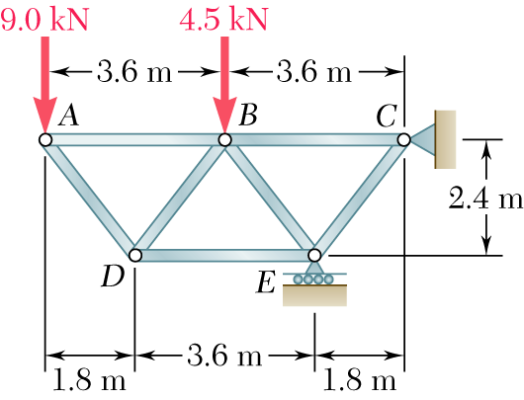
Using the method of joints, determine the force in each member of the truss.

Slide 14
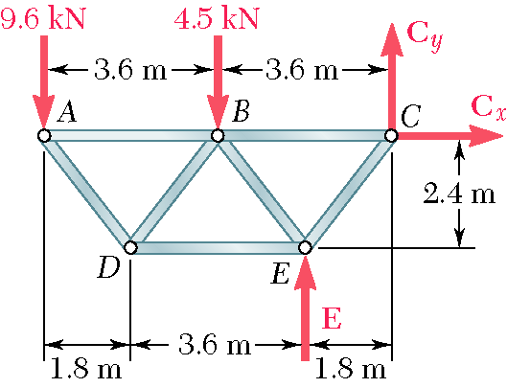
Based on a free-body diagram of the entire truss, solve the 3 equilibrium equations for the reactions at E and C.

Slide 15
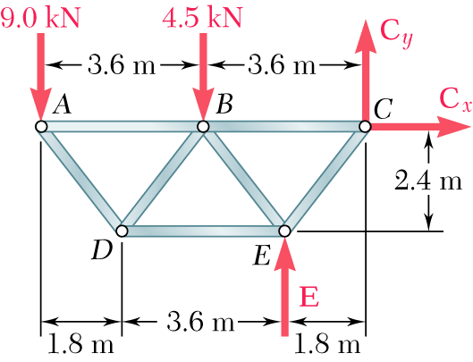
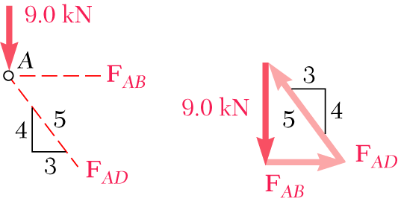
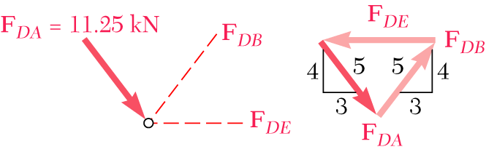
Joint A is subjected to only two unknown member forces. Determine these from the joint equilibrium requirements.
There are now only two unknown member forces at joint D.

Slide 16
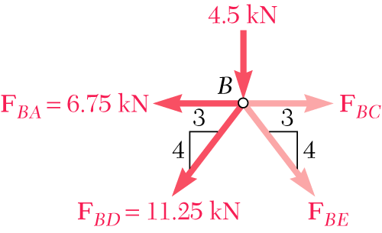
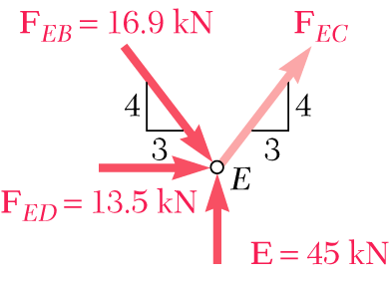
There are now only two unknown member forces at joint B. Assume both are in tension.
There is one unknown member force at joint E. Assume the member is in tension.

Slide 17
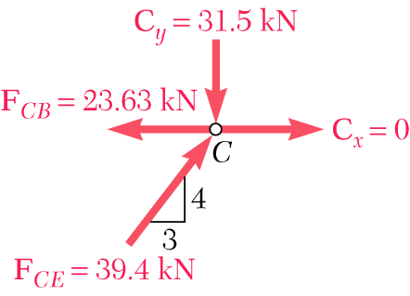
All member forces and support reactions are known at joint C. However, the joint equilibrium requirements may be applied to check the results.

Slide 18
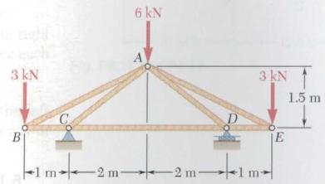
Using the method of joints, determine the forces in each member of the truss.

Slide 19
